Slide 1
Why do i want to work for google
Vorobiov dmytro, ka-72mp

Slide 2
Contents
Intro
Money
Mission statement
Possibilities for self-realization
Awesome team
Transparency
Free food
Weird and wonderful perks
Summary

Slide 3

Intro
While some job interviewers take a fairly unusual approach to interview questions, most job interviews involve an exchange of common interview questions and answers.
Here is one of the most popular question: “So, why do you want to work here?” or “Why do you want to work for us?”. Let's answer this question for Google company.

Slide 4

Money
Salary is important in the most basic sense -- the vast majority of people wouldn't do their jobs if they weren't paid for it. Fair salary for the particular work required is also important. Google pays some of the highest salaries in the tech industry.

Slide 5

Mission statement
Google’s mission statement is “to organize the world’s information and make it universally accessible and useful.” Ever since its beginnings, the company has focused on developing its proprietary algorithms to maximize effectiveness. Google continues to focus on ensuring that people access the information they need.

Slide 6

Possibilities for self-realization
Google offers its employees one of the most innovative work environment cultures. Google cares so much about innovation that it has set forth nine principles of innovation. One of the principles encourages Google employees to spend 20% of their time pursuing innovative ideas that they are passionate about. Products and applications, such as Google News, Google Alerts and Google Maps Street View, have been born from this principle.

Slide 7
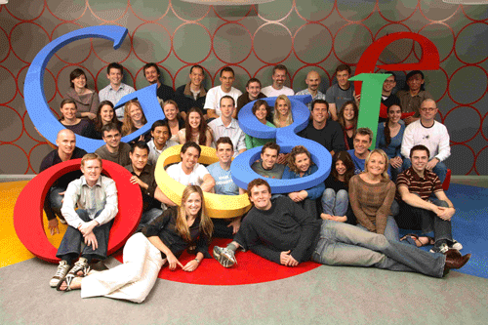
Awesome team
Google looks for the best and brightest minds, and employees are always exposed to other amazing employees and intelligent thinkers. Being around other intelligent thinkers allows for creative work environment, collaboration and disruptive innovation.
Given Google’s large application flow, the company can afford to be pretty picky with who they hire. They’ve put together an all-star team which plays a major role in continued talent attraction.

Slide 8

Transparency
On every software engineers' first day, he or she gets access to almost all of Google's code, every employee can view the personal goals and objectives of every other employee, and the company holds all-hands meetings every Friday where anyone can ask the founders questions about anything.

Slide 9
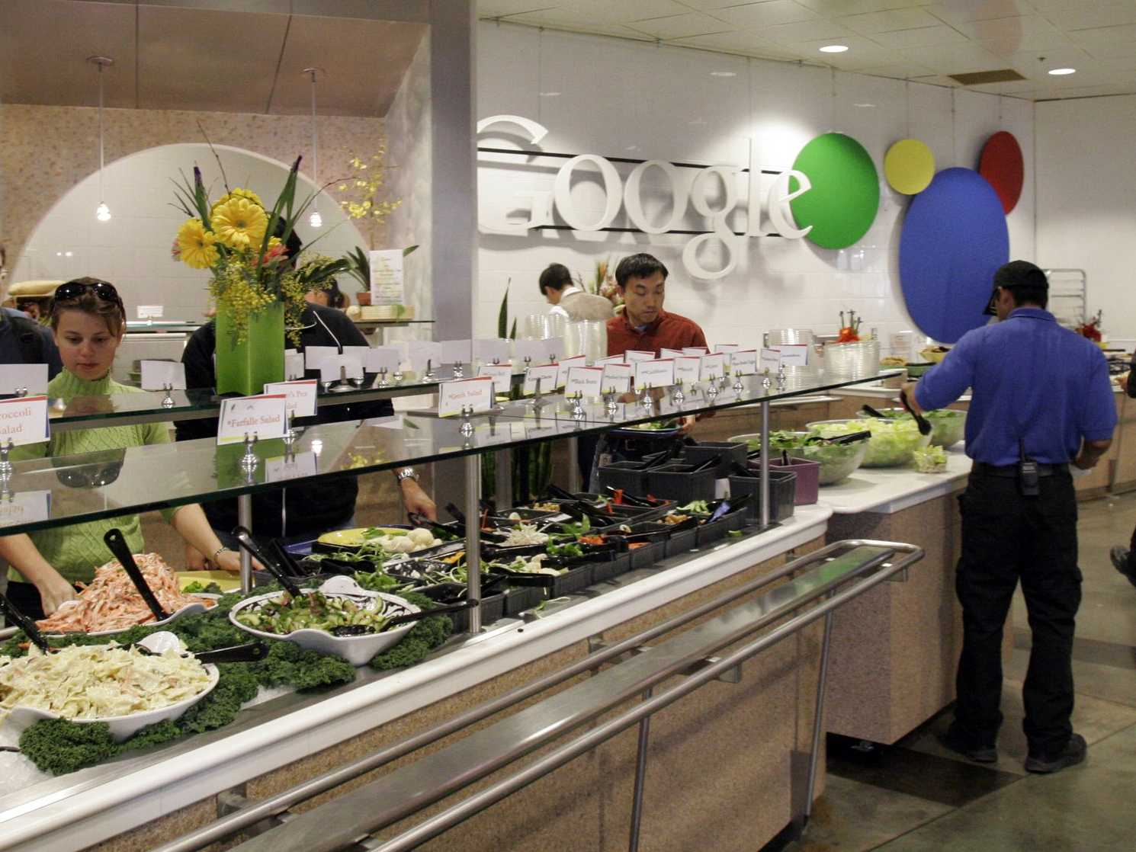
Free food
At the Mountain View campus alone, there are over 36 different cafes that offer a variety of different specialty foods. From fresh sushi to Indian food and exotic salads, Google has become known for their midday feasts.

Slide 10
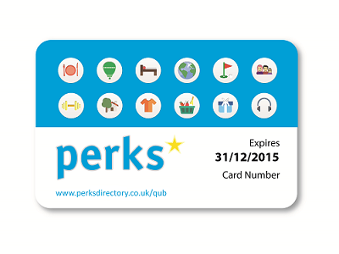
Weird and wonderful perks
Google is famous for throwing tons of perks at its employees.
Free food
Unpaid three month leave of absence
On-site gym
Pets to work
Global Education Leave

Slide 11

Summary
Google is one of the best places to work. 86% of Google employees say they are either extremely satisfied or fairly satisfied with their job.
Googlers have a lot of benefits such as one of the highest salaries, awesome teams with smartest people. Working at Google provides employees with the sense of contributing to the worldwide population. Most Googlers think their work makes the world a better place.

Slide 12
Thank you for your attention

